Slide 1

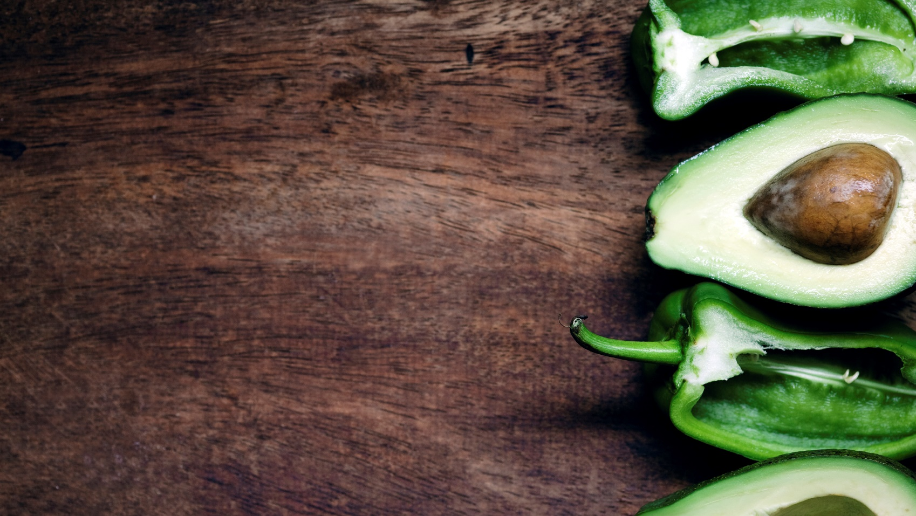
Project nutrino
By Rafay Khan
Notes:
Good afternoon, everyone. Today, I'm excited to introduce you to a revolutionary app that will change the way we think about our food choices: Project Nutrino.

Slide 2
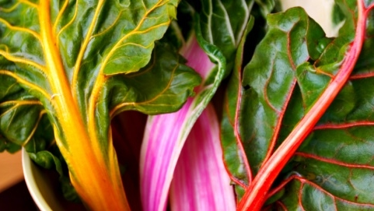
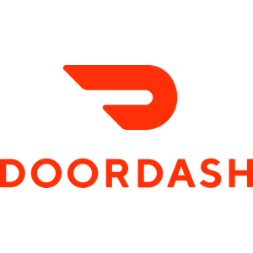
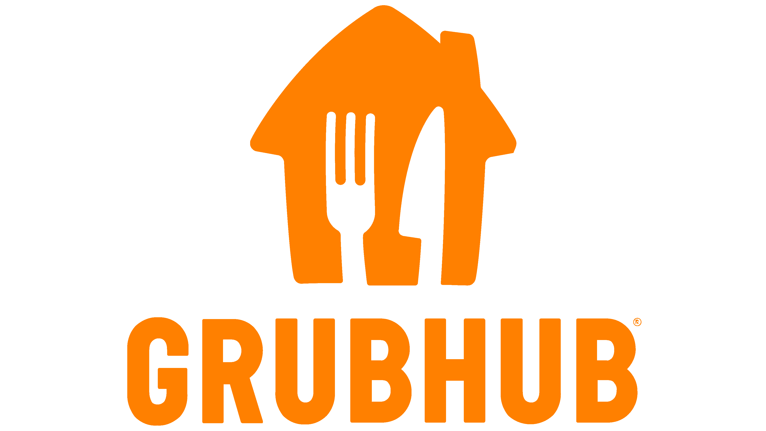
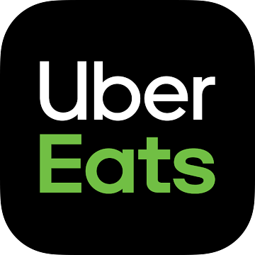

The Problem
Local
Fresh
delicious
Notes:
The Problem our generation faces is that:
We're living in a fast-paced world where food delivery apps have become our go-to solution for convenience. However, we often neglect the nutritional aspect of our meals.
Personally, as someone who tried to adopt a healthier lifestyle during covid while relying heavily on food delivery apps I struggled to find dishes that fit into my diet.
So as consumers, how do we ensure that we're making healthy choices while ordering our favorite dishes?

Slide 3
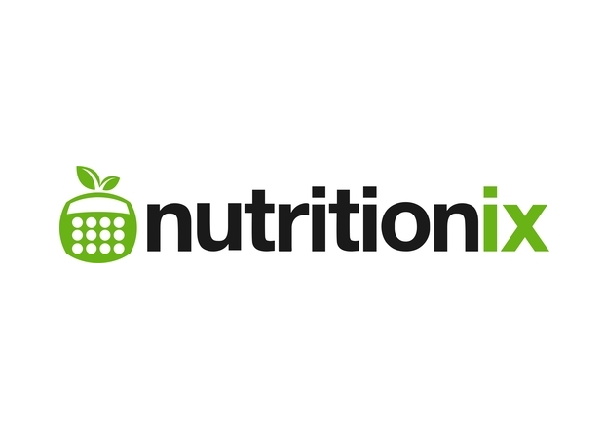
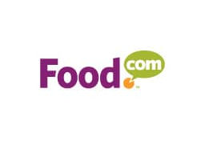


The DatabaseS
Notes:
Project Nutrino collects data from three key sources.
The first being a Food.com Kaggle Database: which will allow us to recommend dishes that you can prepare at home. Whether you're a culinary expert or just getting started, project Nutrino will have the perfect recipe for you.
The second source is Nutritionix Database: Which is a live database which has 209,000 restaurant locations, with open access nutritional information of dishes. This data will be cross referenced with the third data source which will be
Food Delivery Restaurants Near You: to help determine which dishes most closely match your nutritional targets.
Now each of these databases has its own unique sets of problems Nutrionix and apps like Uber eats use APIs which I have had difficulty extracting data out of due to my inexperience in implementing them. Food.com’s database is quite expansive and is the one I have had the most success with however it required a lot of data cleaning as many of the dishes were either outdated or had incorrect macros. In addition to this while the ingredients are listed the quantities required are unclear.

Slide 4

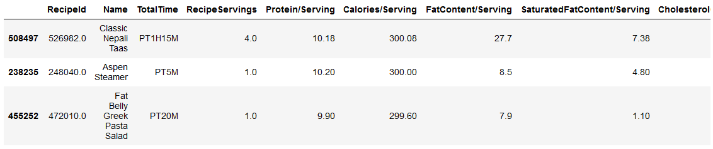
Personalized Recommendation Algorithm
Key Features
Seamless Integration: Project Nutrino integrates with popular food delivery apps, ensuring a smooth user experience.
Live App APIs
Personalized Recommendations: Project Nutrino suggests healthier alternatives based on your dietary preferences, nutritional goals and macro-nutrient requirements.
Combination of K-Nearest Neighbors and Point Distances

Slide 5
The Impact
Improved Health and Wellness
Dietary Awareness
Customized Nutrition
Allergen Management
Reduction in Health Care Costs
Notes:
Project Nutrino empowers individuals to make healthier food choices, fostering a positive impact on their overall well-being. By offering detailed nutritional information and personalized recommendations, users can better manage their diets, leading to improved health outcomes.
The app increases awareness of dietary choices and makes you an active participant in your health rather than a passive one.
Additionally, By promoting healthier eating habits, Nutrino has the potential to reduce the long-term health care costs associated with diet-related diseases such as obesity, diabetes, and heart disease.

Slide 6
Next Steps!

Slide 7
Thank you! Questions?

